Slide 1
Broad College Secondary Admission Information Session (Fall 2024)

Slide 2
Agenda
Admission Process Timeline
What Does “Competitive Admission” Mean?
Academic Factors
Experiential Profile
Case Study
Statement of Extenuating Circumstances
Transfer Credit
Considerations When Reapplying
Myths and Urban Legends
Schedule Planning for Next Semester

Slide 3
Admission Process Timeline
Application Opens: September 4, 2024
Deadline to Begin a New Application: October 17, 2024
Experiential Profile & Case Study Deadline: 5:00pm, October 17, 2024 (there is no “submit” button; applicants can edit their responses until the deadline)
Dual-Enrolled Course Documentation Deadline: December 20, 2024, at 8:00pm (unofficial documentation submitted via email to admissions@broad.msu.edu)
Admission Decisions: Notifications sent via Office of the Registrar’s Confidential Message January 3, 2025, after 5:00pm (ET).
Students will be admitted directly into the major of their choice.

Slide 4
What Does “Competitive Admission” Mean?
Admission to Broad is competitive, and seats are limited
Competitiveness of admission is determined by the pool of applicants and varies each semester.
Factors impacting competitiveness that are OUTSIDE of your control:
Size of overall applicant pool
Academic competitiveness of overall applicant pool
Number of available seats (determined at the end of each admission period just prior to admission decisions)
Final minimum score required for admission this semester
Factors impacting competitiveness that are WITHIN your control:
Your academic performance/grades
Your use of available resources to learn about and prepare for the non-academic parts of the application

Slide 5
What Does “Competitive Admission” Mean?
Maximum point totals for each admission factor:
Cumulative GPA: 60
College Precore GPA: 60
Experiential Profile: 30
Case Study: 24
TOTAL: 174
Spring 2024 minimum score required for admission: 157 (out of 172)
This is NOT a guaranteed admissible score for future semesters.

Slide 6
Academic Factors
Completion of 28 credits (minimum)
Completion of CSE 102
Cumulative GPA (only MSU grades are used)
College Precore GPA
STT 200/201/315
Tier 1 Writing Course (WRA 101)
EC 201 and/or EC 202
CSE 102 is NOT calculated into the College Precore GPA
Cumulative GPA and College Precore GPA equally weighted
60 points maximum for each
Apply DURING the semester in which you will complete the academic requirements

Slide 7
Academic Factors
I took both EC 201 & 202; which EC grade will be used?
If both EC courses are completed, both courses/grades will be factored into the College Precore GPA per the formula for Transfer College Precore Courses (next slide).
I took both STT 200 & 201; which grade will be used?
The first chronological grade earned in a precore course will be used (substitute course grades completed later cannot be used).
Example: Spring 2024 grade in STT 201 cannot replace the Fall 2023 grade in STT 200
One or more of my grades is S/NS or CR-NC. How will that be considered?
All original numeric grades will be calculated into the cumulative and College Precore GPAs for admission purposes, unless the S/NS is from Spring 2020, the CR-NC is from Spring 2023, or CR-NC from other semesters is not an admission requirement.
If you repeated a course that was designated as S/NS or CR-NC, the new (repeat) numeric grade will be used in GPA calculations.

Slide 8
Academic Factors
Approved substitutions for required courses
CSE 102: EGR 102, CSE 220, CSE 231, CMSE 201
WRA 101-195H: LB 133, MC 111, MC 112, RCAH 111
STT 200/201/315: STT 180, STT 231, STT 351, STT 421, STT 441, PSY 295
EC 201/202: EC 251H, EC 301 / EC 252H, EC 302
Transfer/Test Credit College Precore Courses
0 precore completed with MSU grade= transfer grades & test credit grade equivalencies used
1 precore completed with MSU grade = transfer grades & test credit grade equivalencies will be reviewed
2 or more precore completed with MSU grade = only MSU grades used

Slide 9
AP Exam Scores/Credit
College Board Advanced Placement Program Equivalencies (Only used if less than 2 College Precore course grades at MSU)
Economics - Micro | 5 | 3 credits | EC 201 | Use 4.0 grade for EC 201 in College Precore GPA
Exam 34 | 4 | 3 credits | EC 201 | Use 4.0 grade for EC 201 in College Precore GPA
Economics - Macro | 5 | 3 credits | EC 202 | Use 4.0 grade for EC 202 in College Precore GPA
Exam 35 | 4 | 3 credits | EC 202 | Use 4.0 grade for EC 202 in College Precore GPA
Statistics | 5 | 3 credits | STT 200 | Use 4.0 grade for STT 200 in College Precore GPA
Exam 90 | 4 | 3 credits | STT 200 | Use 4.0 grade for STT 200 in College Precore GPA
English Language & Comp | 5 | 4 credits | WRA 101 | Use 4.0 grade for WRA101 in College Precore GPA
Exam 36
or
English Literature & Comp | 4 | 4 credits | WRA 101 | Use 4.0 grade for WRA 101 in College Precore GPA
Exam 37 or | 3 | 0 credit | Waive WRA 101 | Must Take WRA 101
Capstone Research Exam 23 | 2 or 1 | No credit
Michigan State University
College Board Advanced Placement Program Equivalencies
Calculus AB | 5 | 3 credits | MTH 132 | Substitute for MTH 124 use 4.0 grade
Exam 66 | 4 | 3 credits | MTH 132 | Substitute for MTH 124 use 3.5 grade
Calculus BC | 5 or 4 | 7 credits | MTH 132, 133 | Substitute for MTH 124 use 4.0 grade
Exam 68 | 3 | 7 credits | MTH 132, 133 | Substitute for MTH 124 use 3.5 grade
NOTE: The student must choose whether to keep the AP exam results or the MSU enrollment as the student cannot receive credit for both - whether MTH is honors or not.
Computer Science A | 5 | 4 credits | CSE 231 | Substitute for CSE 101 use 4.0 grade
Exam 31 | 4 | 4 credits | CSE 231 | Substitute for CSE 101 use 3.5 grade
English* | 5 | 4 credits | WRA 101 | Substitute for WRA 101 use 4.0 grade
Language & Composition
Exam 36
and/or | 4 | 4 credits | WRA 101 | Substitute for WRA 101 use 3.5 grade
Literature & Composition | 3 | 0 credit | Waive WRA 101 | Must Take WRA 101
Exam 37 | 2 or 1 | No credit
Michigan State University
International Baccalaureate Program Equivalencies
Note: MSU recognizes subjects taken at the higher level (HL). This table reflects HL subject equivalencies.
IB Subject | Score | Credit or Waive | MSU Course | Grade used for Broad College Precore
Computer Science | 7, 6, or 5 | 3 credits | CSE GCU | MUST TAKE CSE 101
English A - Literature | 7 or 6 | 8 credits | WRA 150 (Tier I requirement)/ GCU | 4.0
 | 5 | 4 Credits | WRA 150 | 3.5
Mathematics | 7 | 12 credits | MTH 116, 132, 133 | 4.0
Mathematics | 6 | 12 credits | MTH 116, 132, 133 | 4.0
Michigan State University
College Level Examination Program (CLEP) Practices and Policies
(Minimum scores based on computer-based testing environment)
Examination | Min. Score | Credits |  | Grade used for Broad College Precore
American Literature | 50 | 4 | ENG, GCU* | Must Take WRA 110-150
Analyzing and Interpreting Literature | 50 | 4 | ENG, GCU* | Must Take WRA 110-150
English Literature | 50 | 4 | ENG, GCU* | Must Take WRA 110-150
College Algebra | 50 | 3 | MTH 103 | 4.0
Pre-calculus | 50-79 | 3 | MTH 103 | 4.0
 | 80 | 5 | MTH 116 | 4.0

Slide 10
IB Scores/Credit
International Baccalaureate Program Equivalencies
Note: MSU recognizes subjects taken at the higher level (HL). This table reflects HL subject equivalencies. (Only used if less than 2 College Precore course grades at MSU)
IB Subject | Score | Credit or Waive | MSU Course | Grade used for Broad College Precore GPA
English A - Literature | 7 or 6 | 8 credits | WRA 101 (Tier I requirement)/ GCU | 4.0
 | 5 | 4 Credits | WRA 101 | 4.0
Economics | 7 or 6 | 6 credits | EC 201, EC 202 | 4.0 for both courses
Mathematics (IB187 – IB192) | 7 or 6 or 5 | 15 credits | MTH 116, MTH 132, MTH 133, STT 200 | 4.0 (for STT 200)
International Baccalaureate Program Equivalencies
Note: MSU recognizes subjects taken at the higher level (HL). This table reflects HL subject equivalencies.
IB Subject | Score | Credit or Waive | MSU Course | Grade used for Broad College Precore
Computer Science | 7, 6, or 5 | 3 credits | CSE GCU | MUST TAKE CSE 101
English A - Literature | 7 or 6 | 8 credits | WRA 150 (Tier I requirement)/ GCU | 4.0
 | 5 | 4 Credits | WRA 150 | 3.5
Mathematics | 7 | 12 credits | MTH 116, 132, 133 | 4.0
Mathematics | 6 | 12 credits | MTH 116, 132, 133 | 4.0
Michigan State University
College Level Examination Program (CLEP) Practices and Policies
(Minimum scores based on computer-based testing environment)
Examination | Min. Score | Credits |  | Grade used for Broad College Precore
American Literature | 50 | 4 | ENG, GCU* | Must Take WRA 110-150
Analyzing and Interpreting Literature | 50 | 4 | ENG, GCU* | Must Take WRA 110-150
English Literature | 50 | 4 | ENG, GCU* | Must Take WRA 110-150
College Algebra | 50 | 3 | MTH 103 | 4.0
Pre-calculus | 50-79 | 3 | MTH 103 | 4.0
 | 80 | 5 | MTH 116 | 4.0

Slide 11
CLEP Scores/Credit
College Level Examination Program (CLEP) Equivalencies (Only used if less than 2 College Precore course grades at MSU)
(Minimum scores based on computer-based testing environment)
Examination | Min. Score | Credits |  | Grade used for Broad College Precore
Principles of Microeconomics | 50 | 3 | EC 201 | 4.0
Principles of Macroeconomics | 50 | 3 | EC 202 | 4.0
College Level Examination Program (CLEP) Practices and Policies
(Minimum scores based on computer-based testing environment)
Examination | Min. Score | Credits |  | Grade used for Broad College Precore
American Literature | 50 | 4 | ENG, GCU* | Must Take WRA 110-150
Analyzing and Interpreting Literature | 50 | 4 | ENG, GCU* | Must Take WRA 110-150
English Literature | 50 | 4 | ENG, GCU* | Must Take WRA 110-150
College Algebra | 50 | 3 | MTH 103 | 4.0
Pre-calculus | 50-79 | 3 | MTH 103 | 4.0
 | 80 | 5 | MTH 116 | 4.0
*There is no College Precore grade equivalency for A-level credit.

Slide 12
Academic Factor Points
Fall 2024
MSU Cumulative GPA |  |  | 4 | 3.9 - 3.999 | 3.8 - 3.899 | 3.7 - 3.799 | 3.6 - 3.699 | 3.5 - 3.599 | 3.4 - 3.499 | 3.3 - 3.399 | 3.2 - 3.299 | 3.1 - 3.199 | 3.0 - 3.099 | 2.9 - 2.999 | 2.8 - 2.899 | 2.7 - 2.799 | 0.0 - 2.699
Rate |  |  | 60 | 59 | 58 | 57 | 56 | 55 | 54 | 53 | 52 | 51 | 50 | 40 | 30 | 20 | 10
College Precore GPA | Rate
4 | 60 |  | 120 | 119 | 118 | 117 | 116 | 115 | 114 | 113 | 112 | 111 | 110 | 100 | 90 | 80 | 70
3.9 - 3.999 | 59 |  | 119 | 118 | 117 | 116 | 115 | 114 | 113 | 112 | 111 | 110 | 109 | 99 | 89 | 79 | 69
3.8 - 3.899 | 58 |  | 118 | 117 | 116 | 115 | 114 | 113 | 112 | 111 | 110 | 109 | 108 | 98 | 88 | 78 | 68
3.7 - 3.799 | 57 |  | 117 | 116 | 115 | 114 | 113 | 112 | 111 | 110 | 109 | 108 | 107 | 97 | 87 | 77 | 67
3.6 - 3.699 | 56 |  | 116 | 115 | 114 | 113 | 112 | 111 | 110 | 109 | 108 | 107 | 106 | 96 | 86 | 76 | 66
3.5 - 3.599 | 55 |  | 115 | 114 | 113 | 112 | 111 | 110 | 109 | 108 | 107 | 106 | 105 | 95 | 85 | 75 | 65
3.4 - 3.499 | 54 |  | 114 | 113 | 112 | 111 | 110 | 109 | 108 | 107 | 106 | 105 | 104 | 94 | 84 | 74 | 64
3.3 - 3.399 | 53 |  | 113 | 112 | 111 | 110 | 109 | 108 | 107 | 106 | 105 | 104 | 103 | 93 | 83 | 73 | 63
3.2 - 3.299 | 52 |  | 115 | 111 | 110 | 109 | 108 | 107 | 106 | 105 | 104 | 103 | 102 | 92 | 82 | 72 | 62
3.1 - 3.199 | 51 |  | 111 | 110 | 109 | 108 | 107 | 106 | 105 | 104 | 103 | 102 | 101 | 91 | 81 | 71 | 61
3.0 - 3.099 | 50 |  | 110 | 109 | 108 | 107 | 106 | 105 | 104 | 103 | 102 | 101 | 100 | 90 | 80 | 70 | 60
2.9 - 2.999 | 40 |  | 100 | 99 | 98 | 97 | 96 | 95 | 94 | 93 | 92 | 91 | 90 | 80 | 70 | 60 | 50
2.8 - 2.899 | 30 |  | 90 | 89 | 88 | 87 | 86 | 85 | 84 | 83 | 82 | 81 | 80 | 70 | 60 | 50 | 40
2.7 - 2.799 | 20 |  | 80 | 79 | 78 | 77 | 76 | 75 | 74 | 73 | 72 | 71 | 70 | 60 | 50 | 40 | 30
0.0 - 2.699 | 10 |  | 70 | 69 | 68 | 67 | 66 | 65 | 64 | 63 | 62 | 61 | 60 | 50 | 40 | 30 | 20
MSU Cumulative GPA |  |  | 4 | 3.9 - 3.99 | 3.8 - 3.89 | 3.7 - 3.79 | 3.6 - 3.69 | 3.5 - 3.59 | 3.4 - 3.49 | 3.3 - 3.39 | 3.2 - 3.29 | 3.1 - 3.19 | 3.0 - 3.09 | 2.9 - 2.99 | 2.8 - 2.89 | 2.7 - 2.79 | 0.0 - 2.69
Rate |  |  | 61 | 59 | 58 | 57 | 56 | 55 | 54 | 53 | 52 | 51 | 50 | 40 | 30 | 20 | 15
College Precore GPA | Rate
4.0 | 61 |  | 122 | 120 | 119 | 118 | 117 | 116 | 115 | 114 | 113 | 112 | 111 | 101 | 91 | 81 | 76
3.8 - 3.99 | 60 |  | 121 | 119 | 118 | 117 | 116 | 115 | 114 | 113 | 112 | 111 | 110 | 100 | 90 | 80 | 75
3.6 - 3.79 | 59 |  | 120 | 118 | 117 | 116 | 115 | 114 | 113 | 112 | 111 | 110 | 109 | 99 | 89 | 79 | 74
3.4 - 3.59 | 58 |  | 119 | 117 | 116 | 115 | 114 | 113 | 112 | 111 | 110 | 109 | 108 | 98 | 88 | 78 | 73
3.2 - 3.39 | 57 |  | 118 | 116 | 115 | 114 | 113 | 112 | 111 | 110 | 109 | 108 | 107 | 97 | 87 | 77 | 72
3.1 - 3.19 | 56 |  | 117 | 115 | 114 | 113 | 112 | 111 | 110 | 109 | 108 | 107 | 106 | 96 | 86 | 76 | 71
3.0 - 3.09 | 55 |  | 116 | 114 | 113 | 112 | 111 | 110 | 109 | 108 | 107 | 106 | 105 | 95 | 85 | 75 | 70
2.9 - 2.99 | 40 |  | 101 | 99 | 98 | 97 | 96 | 95 | 94 | 93 | 92 | 91 | 90 | 80 | 70 | 60 | 55
2.8 - 2.89 | 30 |  | 91 | 89 | 88 | 87 | 86 | 85 | 84 | 83 | 82 | 81 | 80 | 70 | 60 | 50 | 45
2.7 - 2.79 | 20 |  | 81 | 79 | 78 | 77 | 76 | 75 | 74 | 73 | 72 | 71 | 70 | 60 | 50 | 40 | 35
0.0 - 2.69 | 15 |  | 76 | 74 | 73 | 72 | 71 | 70 | 69 | 68 | 67 | 66 | 65 | 55 | 45 | 35 | 30

Slide 13
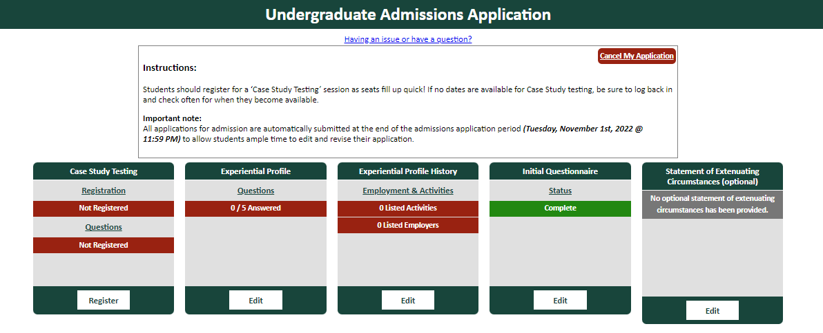
Application Main Page

Slide 14
Experiential Profile Overview
30 points maximum
Profile Sections
Employment & Activities
Essay Questions
Scoring Categories (equally weighted)
Motivation & Enthusiasm (passion for area of study)
Engagement & Commitment (active engagement in past & present experiences)
Resilience (demonstration of the ability to overcome a struggle and persist)
Positive Self-Concept (confidence, self-esteem, independence)
Written Communication Skills (use of English language conventions – mechanics, grammar)
Deadline: October 17, 5:00pm (Eastern Time)
No “submit” button – we upload your saved content

Slide 15
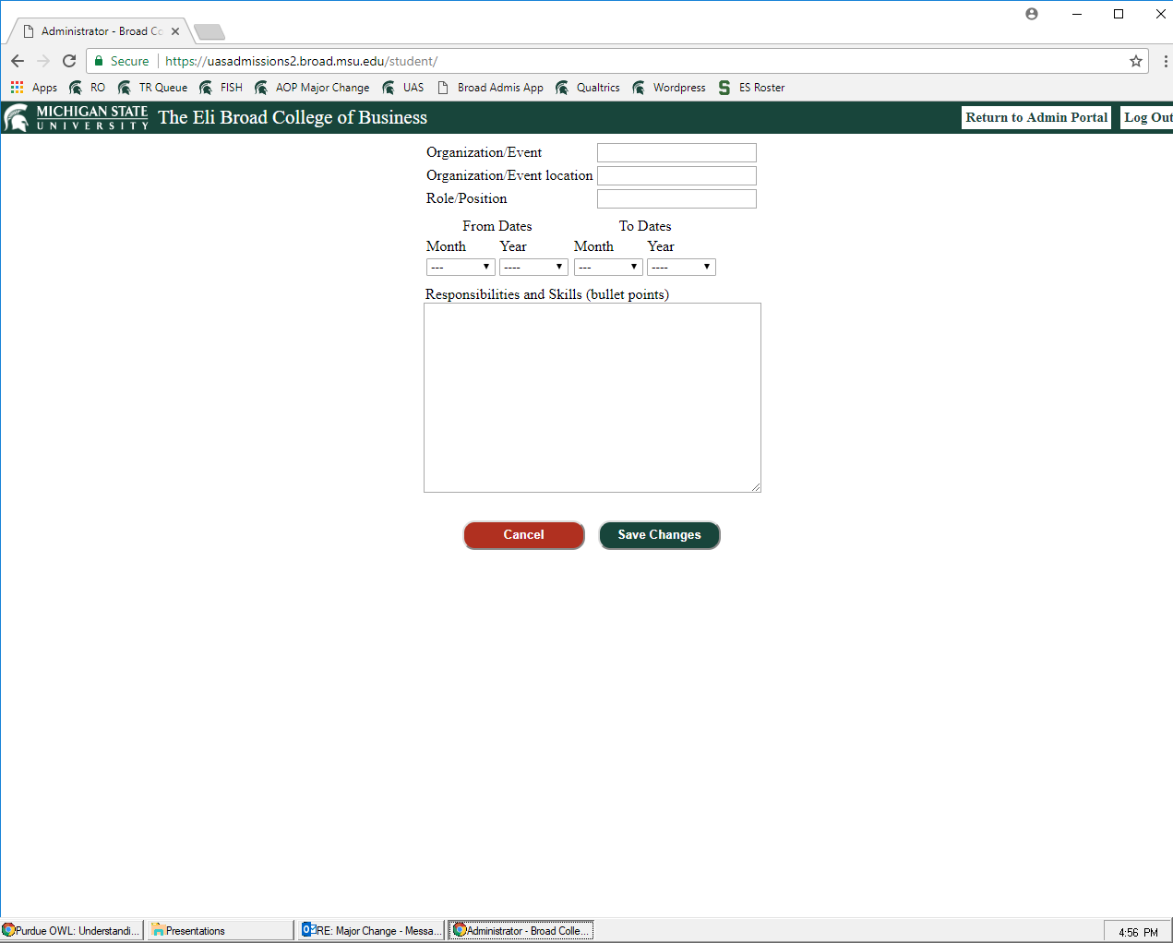
Employment & Activities

Slide 16
Employment & Activities
Post-high school experiences, if possible, but significant high school experiences acceptable (limit to junior & senior years)
Examples of “employment”: internship, part-time/summer job, significant volunteer experience
Examples of “activity”: student organizations, study abroad programs (that you have already completed), community service, student government, leadership positions on athletic teams
Must include at least one employment OR one activity for profile to be accepted
Dates:
Current involvement should be listed as through the end of this semester (December 2024) or leave the end date blank
Employment that was exactly the same for multiple summers should include the entire date range (June 2022 – August 2024), with the word “Summers” at the top of the skills section

Slide 17
Employment & Activities
Responsibilities & Skills section
Bullet point format
Like resume content – how many bullet points?
As many as you need, but 3-5 is average
Use WHO Method to develop bullet points

Slide 18
Evidence-Based Bullets
The W.H.O method provides evidence to the reader (employer) as it outlines: What you did, How you did it, and the Outcome or result of your action(s)
Tips:
Utilize a variety of action verbs – do not repeat!
Quantify at any opportunity (percentages, dollar figures and/or hard numbers)
Notes:
Goal:
Introduce the W.H.O. method for bullet point development
Highlight each aspect of the method, and include the tips that are provided in the picture!
“What:” Even if you are currently in the position make sure to use past-tense action verbs
“How:” state what skills, strategies, methods, tools, techniques or attitudes you utilized to accomplish the task.
“Outcome/Result:” Think impact, contribution, intention and/or scope – Quantify at any opportunity!

Slide 19
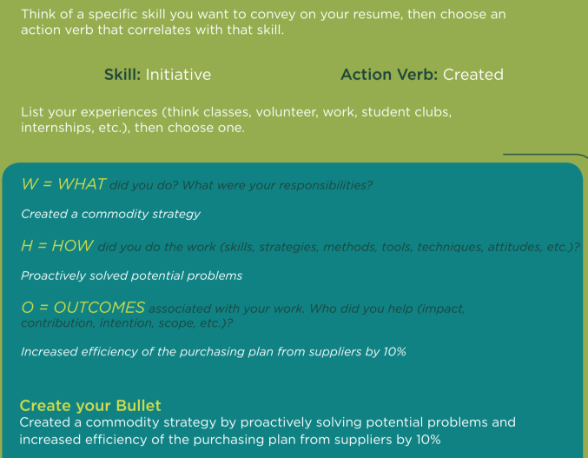
The W.H.O. Method in Action
Notes:
The steps to forming a bullet point…
Think of a specific (soft-skill) you want to convey on your resume, then choose an action verb that correlates with that skill.
*Click to next slide*
Utilize the W.H.O. method by breaking down the bullet into the 3 separate aspects of the method
Bring them together to form a cohesive bullet point
*Typically on a word document your bullet points should be no longer than 2 lines – you want your bullet to be detailed, but also concise*

Slide 20
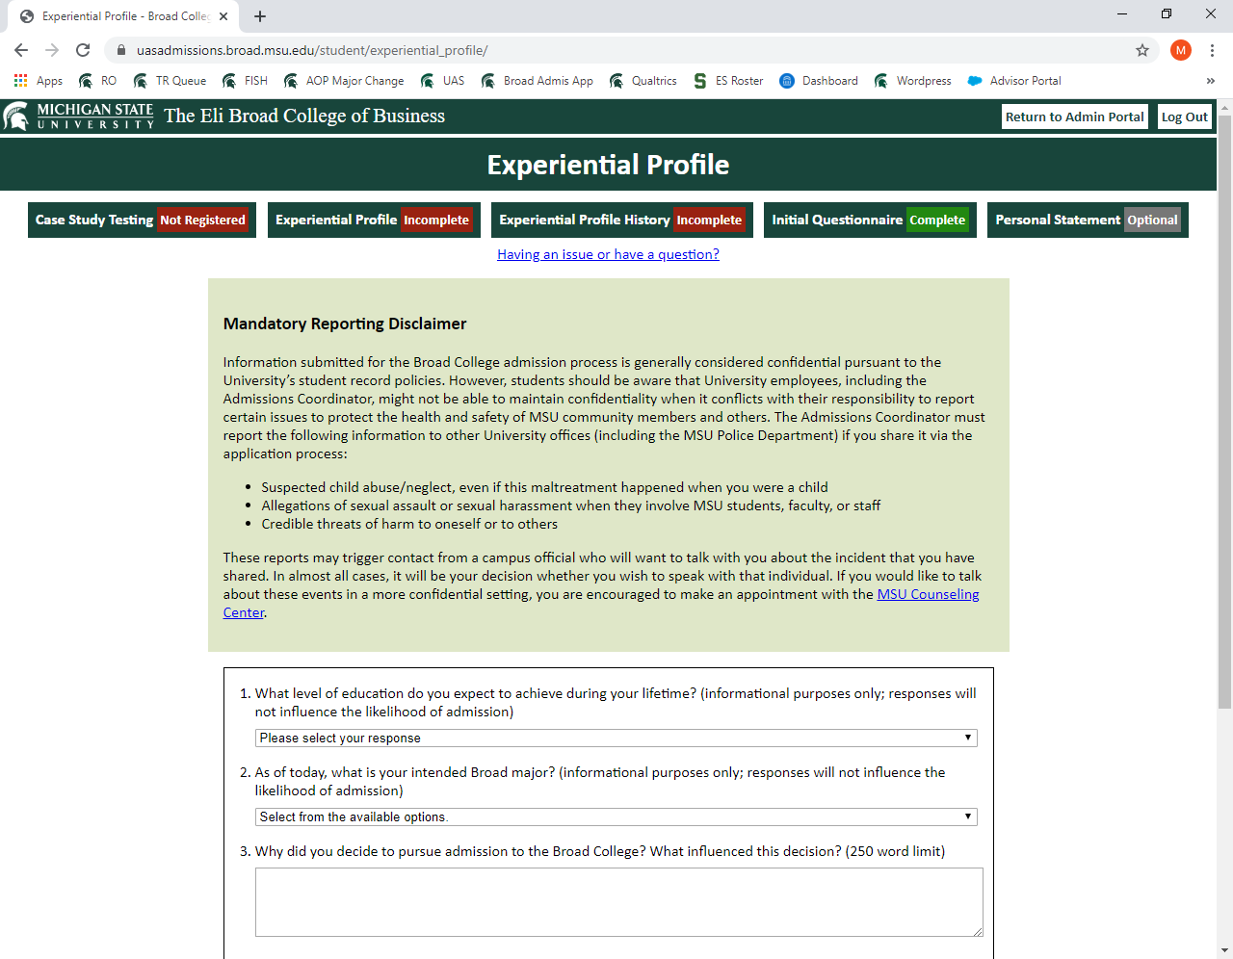
Essay Questions
Education Level Achievement & Intended Major will not influence admission decision

Slide 21
Essay Questions
Why did you decide to pursue admission to the Broad College? What influenced this decision?
What do you see as a significant challenge you have faced? How did you overcome this challenge? Where did you go for support?
NOTE: there is no restriction on the “type” of challenge
Discuss one accomplishment, activity, or experience that best demonstrates why you are a competitive candidate for admission to the Broad College. Confine your response to a single accomplishment/activity/experience that occurred no earlier than one year prior to high school graduation.
250 word maximum limit for each response

Slide 22
Case Study
24 points maximum
Scoring Categories (equally weighted)
Conventions (use of language, command of standard written English, grammar/mechanics)
Organization (organization of thought and structure)
Content (supported central claim)
Critical Thinking & Analysis
500 word maximum limit
Writing Prompt
Consider your intended Broad College major, the career path you wish to pursue after graduation, and the accomplishment/activity/experience you discussed in the final Experiential Profile essay question.
Choose a current business event or issue related to your intended major and/or career path, and describe how the skills and knowledge you gained from that experience prepared you to engage with the event/issue.

Slide 23
Case Study Access
Steps to complete the Case Study
Click the “Register” button – you will be automatically “registered”
Click the “Start Case Study” button at the top of the screen to access the Case Study – you will click this button any time you want to update/edit your content
Be sure to click the “Save Changes” button when you edit your content
A short instructional video covering these steps is available on the Secondary Admission page
There is no time limit to work on the Case Study; it is open until the application deadline (October 17, 2024, at 5:00pm (ET))

Slide 24
Non-Academic Factor Tips
Don’t repeat the question verbatim – you have word limits!
Don’t use unnecessarily large words that you would not normally use. The “synonym” function is not always your friend.
Answer authentically! If you were asked the question in an in-person admission interview, is that what you would say? What do you want the reader to know about you (as related to the specific question)?
Practice business writing (not creative/fiction writing) – clear, concise, complete
Do your own work – the reader can tell if you are using someone else’s words.
This is your opportunity to tell us about yourself.
Answer all parts of the question/prompt
Quality counts – grammar, spelling, mechanics; college-level writing is expected.
Proofread, proofread, proofread
Take these portions of the application process seriously – strong grades are not the only factor in the admission decision.

Slide 25
General Application System Tips
Do not wait until the last minute to add content! There are no extensions.
If you leave the application open on your device, you may time out and new content will not be saved (there are messages that pop up) – always double-check by logging back in and viewing your content.
There is no “submit” button. Applicants can edit their responses until the deadline (October 17, 2024, at 5:00pm ET).

Slide 26
Resources After This Session
Palmer Center’s Broad Student Career Guide (broad.msu.edu/career-management/undergraduate/)
Writing Center (writing.msu.edu/)
This presentation will be online at broad.msu.edu/undergraduate/admissions/secondary/
Reminder: advisors & peer coaches do not review individual student Experiential Profile and Case Study content.

Slide 27
Statement of Extenuating Circumstances
The statement of extenuating circumstance is an opportunity for a student to share a circumstance beyond his/her control which impacted academic performance. Official supportive documentation of the extenuating circumstance must be submitted to admissions@broad.msu.edu.
Examples of reasons to include a statement:
Medical illness
Family emergency
This is not a “personal statement” like some college/program applications.

Slide 28
Statement of Extenuating Circumstances
Should I submit a Statement of Extenuating Circumstances about the pandemic and/or the incident that occurred February 2023?
While these events have impacted many, or even all, students, we recognize that students have been impacted differently. Any applicant is welcome to submit a statement through the application system; while the presence of a statement is not itself a guarantee of admission, the statement will allow the Admission Committee to consider a student’s individual situation when reviewing their overall application profile. All statements must be substantiated with accompanying documentation.
What if an extenuating circumstance occurred after the application closed?
For full consideration, students can submit a statement via email to admissions@broad.msu.edu by the last day of the current semester. Substantiating documentation must accompany the statement.

Slide 29
Transfer Credit
Repeating MSU courses through transfer credit
Must earn 2.0/C grade or higher to receive transfer credit
Once transcript is applied to your academic record, the original course grade will be removed from your GPA (and precore GPA, if it is a precore course)
Grade from the other institution is not used in cumulative GPA calculation; see Slide 8 for how/when transfer course grades are used in the College Precore GPA
Credit from prior semester courses must be reflected on your academic record as “accepted credit” by December 19. Unofficial documentation cannot be accepted.
Declare current dual enrollment in the application system
Institution name, course code, credit number, semester end date
ONLY NON-MSU COURSES YOU ARE TAKING IN FALL 2024

Slide 30
Transfer Credit
Documentation of course completion with a transferrable grade must be submitted via email (admissions@broad.msu.edu) by 8:00pm, December 20.
Acceptable: Screenshot of final semester grade (like MSU’s SIS) or electronic unofficial transcript
Unacceptable: letters from instructors/school officials, semester progress grades, D2L-style gradebook screenshots
Courses that end and/or grades that are not made available until after the December 20 deadline will not be considered in this semester’s admission decision process. Students who choose to complete courses that do not meet this deadline must apply in the next available application period.
Official transcripts (showing final grades) must be sent to the Office of Admissions (NOT the Broad College).

Slide 31
Reapplying?
Improve your GPA
Maximize repeat courses, if applicable
Take a reasonable course load this semester to ensure maximum GPA improvement through high grades
Use academic support services (tutoring, workshops, help rooms, study sessions, office hours)
Strengthen your non-academic factors
Use the resources outlined in this presentation
Proofread, proofread, proofread
Remember that this is a different admission cycle, so non-academic factor ratings, average GPAs and admission point cut-offs will be different
Do not expect the same score on the non-academic factors from one semester to the next. The Broad College continues to refine the scoring process, and submissions are read competitively across the applicant pool. A small score difference, even for the same submission, is not unexpected.
You must enter a new Experiential Profile & Case Study THIS SEMESTER – responses from previous semesters are not saved, and scores from previous semesters will not be used.

Slide 32
Myths and Urban Legends
You get extra points for attending an infosession, advising appointment, etc.
While we track attendance at such events, it is for planning purposes, and to document your attendance so we are aware of your level of exposure to the admission process. No points are associated – but it is in your best interest to be as informed as possible.
You can’t apply if you have more than 56 credits/have already applied once, twice, etc.
The Broad College does not limit access to the application based on credit total (once you meet the minimum application requirements), current major, or number of previous applications.
It’s easier to get admitted in _____ semester.
Both fall and spring semester applicant pools are very large and very competitive.
Only ___% of applicants are admitted.
The admit percentage varies each semester, dependent on the size of the applicant pool and the number of available seats. Previous semester admit percentages ranged from 34% to 54%.
Seek advice from Broad advising staff regarding the admissions process. Changes to the criteria, requirements, scoring, and procedures occur periodically, and older students may not be aware of such updates, and so may be unknowingly giving you incorrect advice.

Slide 33
Schedule Planning for Next Semester
Class Schedule Planning Session – October 23 via Zoom
Invitation sent to applicant list after application deadline
Overview of Business Core and general graduation requirements
Opportunity to request personalized Spring 2025 course plan
When can I enroll in Broad-restricted courses?
As soon as you get the admission decision message (January 3 after 5pm)
What do I enroll in when my enrollment appointment opens (before the admission decision)?
Enroll in courses you will take if you are not admitted to Broad
Explore majors outside Broad, meet with a University Advisor or advisors in specific majors (advising.msu.edu/advising-by-college)
DO NOT WAIT FOR THE ADMISSION DECISION TO ENROLL! It is easier to change your schedule to Broad courses than to start from scratch if you are not admitted.

Slide 34
Questions?
Read the FAQ sections
broad.msu.edu/undergraduate/admissions/secondary/
Broad admissions email
admissions@broad.msu.edu
Broad advising email
undergrad@broad.msu.edu

