Slide 1


Slide 2

Template Instructions
This PowerPoint file includes a wide selection of various Slide Layouts for promoting different types of content, organized into different sections for:
  Event Slides
  VIP/Guest Slides
  General Purpose Slides
  Blank Slides

Slide 3
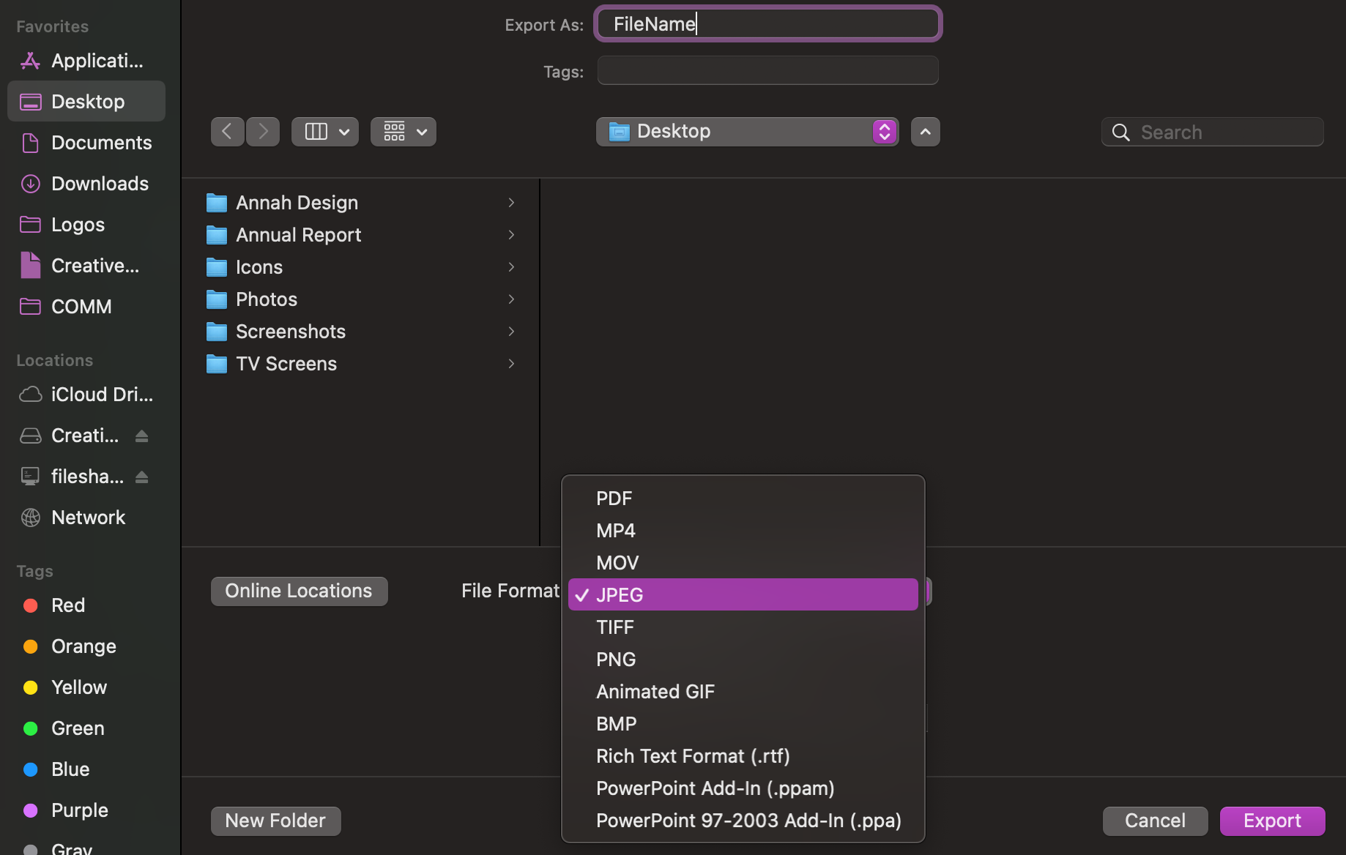
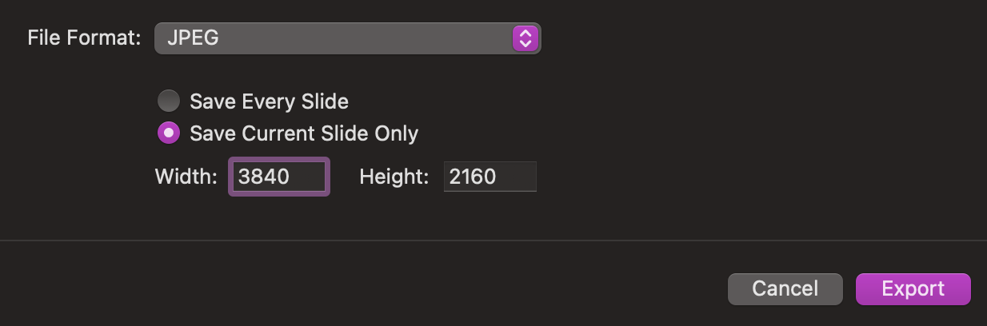
Exporting Instructions
File name
Select slide you want to export
Go to File > Export…
Enter the file name and choose location to save
Select File Format: JPEG or PNG
Check “Save Current Slide”
Change dimensions to 3840 width x 2160 height
Export
Select JPEG or PNG under file format
Enter dimensions

Slide 4
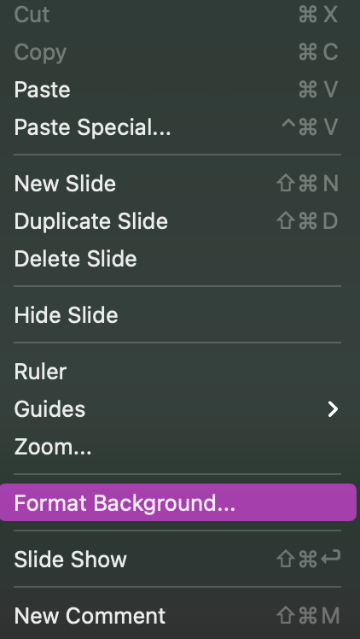
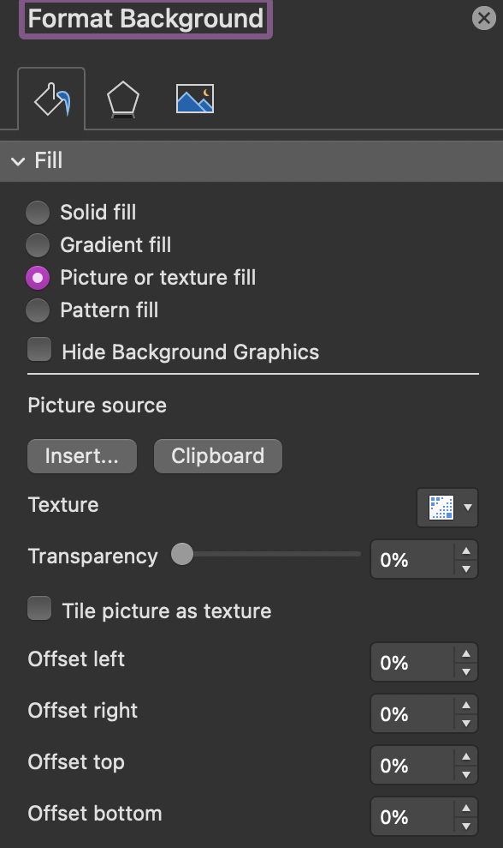
Inserting a photo in
the background
Right click on slide’s background
Click on “Format Background”
Format Background Panel: click ”Picture or texture fill”
Under ”Picture source”, click Insert…
Browse and select your photo

Slide 5


EVENT TITLE
GOES HERE
Date: Day, Month | Time: XX p.m. – XX a.m.
Location: Address
Additional Info:
Logos, contact, etc.
Insert QR Code if desired
REGISTER TODAY | <URL HERE>

Slide 6

EVENT TITLE
GOES HERE
Date: Day, Month | Time: XX p.m. – XX a.m.
Location: Address
Additional Info:
Logos, contact, etc.
REGISTER TODAY | <URL HERE>

Slide 7

EVENT TITLE
GOES HERE
Date: Day, Month | Time: XX p.m. – XX a.m.
Location: Address
Additional Info:
Logos, contact, etc.
REGISTER TODAY | <URL HERE>

Slide 8
EVENT TITLE
GOES HERE
Date: Day, Month | Time: XX p.m. – XX a.m.
Location: Address
Additional Info:
Logos, contact, etc.
REGISTER TODAY | <URL HERE>

Slide 9
EVENT TITLE
GOES HERE
Date: Day, Month | Time: XX p.m. – XX a.m.
Location: Address
Additional Info:
Logos, contact, etc.
REGISTER TODAY | <URL HERE>

Slide 10

First name
Last name
THE BROAD COLLEGE WELCOMES
TITLE, COMPANY
Additional Info:
Logos, contact, etc.

Slide 11

THE BROAD COLLEGE WELCOMES
First name
Last name
TITLE, COMPANY
Additional Info:
Logos, contact, etc.

Slide 12

TITLE
HERE
Description here
For more information, visit us at <URL HERE>

Slide 13
TITLE
HERE
Description here
Insert QR Code if desired
For more information, visit us at <URL HERE>

Slide 14
TITLE
HERE
Description here
Insert QR Code if desired
For more information, visit us at <URL HERE>

Slide 15
TITLE
HERE
Description here
For more information, visit us at <URL HERE>

Slide 16
TITLE
HERE
Description here
For more information, visit us at <URL HERE>

Slide 18


