Slide 1
Secondary/Standard Admission Information Session
Fall 2025
Melanie Wallace
Director of Undergraduate Admissions & Transition Initiatives

Slide 2
Agenda
Admission Process Timeline
What is Competitive Admission?
Academic Factors
Online Application
  Experiential Profile
  Case Study
  Statement of Extenuating Circumstances
Transfer Credit
Reapplying?
Broad Admission Myths & Misconceptions
Spring Schedule Planning

Slide 3
Admission Process Timeline
Application Opens: September 3, 2025
Deadline to Begin a New Application: October 16, 2025
Experiential Profile & Case Study Deadline: 5:00pm, October 16, 2025 (there is no “submit” button; applicants can edit their responses until the deadline)
Dual-Enrolled Course Documentation Deadline: December 22, 2025, at 5:00pm (unofficial documentation submitted via email to admissions@broad.msu.edu)
Admission Decisions: Notifications sent via Office of the Registrar’s Confidential Message January 6, 2026, after 5:00pm (ET).
Students will be admitted directly into the major of their choice.

Slide 4
What is Competitive Admission?
Admission to Broad is competitive, and seats are limited
Competitiveness of admission is determined by the pool of applicants and varies each semester.
Factors impacting competitiveness that are OUTSIDE of your control:
  Size of overall applicant pool
  Academic competitiveness of overall applicant pool
  Number of available seats (determined at the end of each admission period just prior to admission decisions)
  Final minimum score required for admission this semester
Factors impacting competitiveness that are WITHIN your control:
  Your academic performance/grades
  Your use of available resources to learn about and prepare for the non-academic parts of the application

Slide 5
What is Competitive Admission?
Maximum point totals for each admission factor:
  Cumulative GPA: 60
  College Precore GPA: 60
  Experiential Profile: 30
  Case Study: 24
  TOTAL: 174
Past 2 years
  Semester admission rate: 34% - 43%
  Admitted student average GPAs: 3.799 cumulative, 3.814 CPC
Spring 2025 minimum score required for admission: 160
  This is NOT a guaranteed admissible score for future semesters.

Slide 6
Academic Factors
Completion of 28 credits (minimum)
Cumulative GPA (only MSU grades are used)
College Precore GPA
  STT 200/201/315
  Tier 1 Writing Course (WRA 101/195H or equivalent)
  EC 201
  EC 202
Cumulative GPA and College Precore GPA equally weighted
  60 points maximum for each
Apply DURING the semester you will complete the academic requirements

Slide 7
Academic Factors
College Precore approved substitutes
  WRA 101/195H: LB 133, MC 111, MC 112, RCAH 111
  STT 200/201/315: STT 180, STT 231, STT 351, STT 421, STT 441, PSY 295
  EC 201: EC 251H, EC 301
  EC 202: EC 252H, EC 302
Transfer/Test Credit College Precore Courses
  0 precore completed with MSU grade= transfer grades & test credit grade equivalencies used
  1 precore completed with MSU grade = transfer grades & test credit grade equivalencies will be reviewed
  2 or more precore completed with MSU grade = only MSU grades used

Slide 8
Academic Factors
I took both STT 200 & 201; which grade will be used?
  The first chronological grade earned in a precore course will be used (substitute course grades completed later cannot be used).
    Example: Spring 2024 grade in STT 201 cannot replace the Fall 2023 grade in STT 200
One or more of my grades is S/NS or CR-NC. How will that be considered?
  All original numeric grades will be calculated into the cumulative and College Precore GPAs for admission purposes, unless the S/NS is from Spring 2020, the CR-NC is from Spring 2023, or CR-NC from other semesters is not an admission requirement.
  If you repeated a course that was designated as S/NS or CR-NC, the new (repeat) numeric grade will be used in GPA calculations.

Slide 9
Academic Factors
AP Exam Score Grade Equivalencies for College Precore GPA
College Board Advanced Placement Program Equivalencies (Only used if 0 or 1 College Precore course grades at MSU)
Economics - Micro | 5 | 3 credits | EC 201 | Use 4.0 grade for EC 201 in College Precore GPA
Exam 34 | 4 | 3 credits | EC 201 | Use 4.0 grade for EC 201 in College Precore GPA
Economics - Macro | 5 | 3 credits | EC 202 | Use 4.0 grade for EC 202 in College Precore GPA
Exam 35 | 4 | 3 credits | EC 202 | Use 4.0 grade for EC 202 in College Precore GPA
Statistics | 5 | 3 credits | STT 200 | Use 4.0 grade for STT 200 in College Precore GPA
Exam 90 | 4 | 3 credits | STT 200 | Use 4.0 grade for STT 200 in College Precore GPA
English Language & Comp | 5 | 4 credits | WRA 101 | Use 4.0 grade for WRA101 in College Precore GPA
Exam 36
or
English Literature & Comp | 4 | 4 credits | WRA 101 | Use 4.0 grade for WRA 101 in College Precore GPA
Exam 37 or | 3 | 0 credit | Waive WRA 101 | Must Take WRA 101
Capstone Research Exam 23 | 2 or 1 | No credit

Slide 10
Academic Factors
IB Exam Score Grade Equivalencies for College Precore GPA
International Baccalaureate Program Equivalencies
Note: MSU recognizes subjects taken at the higher level (HL). This table reflects HL subject equivalencies. (Only used if 0 or 1 College Precore course grades at MSU)
IB Subject | Score | Credit or Waive | MSU Course | Grade used for Broad College Precore GPA
English A - Literature | 7 or 6 | 8 credits | WRA 101 (Tier I requirement)/ GCU | 4.0
 | 5 | 4 Credits | WRA 101 | 4.0
Economics | 7 or 6 | 6 credits | EC 201, EC 202 | 4.0 for both courses
Mathematics (IB187 – IB192) | 7 or 6 or 5 | 15 credits | MTH 116, MTH 132, MTH 133, STT 200 | 4.0 (for STT 200)

Slide 11
Academic Factors
CLEP Exam Score Grade Equivalencies for College Precore GPA
College Level Examination Program (CLEP) Equivalencies (Only used if 0 or 1 College Precore course grades at MSU)
(Minimum scores based on computer-based testing environment)
Examination | Min. Score | Credits |  | Grade used for Broad College Precore
Principles of Microeconomics | 50 | 3 | EC 201 | 4.0
Principles of Macroeconomics | 50 | 3 | EC 202 | 4.0
No College Precore grade equivalency for A-level credit.

Slide 12
Academic Factors
GPA Point Chart
Fall 2025
MSU Cumulative GPA |  |  | 4 | 3.9 - 3.999 | 3.8 - 3.899 | 3.7 - 3.799 | 3.6 - 3.699 | 3.5 - 3.599 | 3.4 - 3.499 | 3.3 - 3.399 | 3.2 - 3.299 | 3.1 - 3.199 | 3.0 - 3.099 | 2.9 - 2.999 | 2.8 - 2.899 | 2.7 - 2.799 | 0.0 - 2.699
Rate |  |  | 60 | 59 | 58 | 57 | 56 | 55 | 54 | 53 | 52 | 51 | 50 | 40 | 30 | 20 | 10
College Precore GPA | Rate
4 | 60 |  | 120 | 119 | 118 | 117 | 116 | 115 | 114 | 113 | 112 | 111 | 110 | 100 | 90 | 80 | 70
3.9 - 3.999 | 59 |  | 119 | 118 | 117 | 116 | 115 | 114 | 113 | 112 | 111 | 110 | 109 | 99 | 89 | 79 | 69
3.8 - 3.899 | 58 |  | 118 | 117 | 116 | 115 | 114 | 113 | 112 | 111 | 110 | 109 | 108 | 98 | 88 | 78 | 68
3.7 - 3.799 | 57 |  | 117 | 116 | 115 | 114 | 113 | 112 | 111 | 110 | 109 | 108 | 107 | 97 | 87 | 77 | 67
3.6 - 3.699 | 56 |  | 116 | 115 | 114 | 113 | 112 | 111 | 110 | 109 | 108 | 107 | 106 | 96 | 86 | 76 | 66
3.5 - 3.599 | 55 |  | 115 | 114 | 113 | 112 | 111 | 110 | 109 | 108 | 107 | 106 | 105 | 95 | 85 | 75 | 65
3.4 - 3.499 | 54 |  | 114 | 113 | 112 | 111 | 110 | 109 | 108 | 107 | 106 | 105 | 104 | 94 | 84 | 74 | 64
3.3 - 3.399 | 53 |  | 113 | 112 | 111 | 110 | 109 | 108 | 107 | 106 | 105 | 104 | 103 | 93 | 83 | 73 | 63
3.2 - 3.299 | 52 |  | 115 | 111 | 110 | 109 | 108 | 107 | 106 | 105 | 104 | 103 | 102 | 92 | 82 | 72 | 62
3.1 - 3.199 | 51 |  | 111 | 110 | 109 | 108 | 107 | 106 | 105 | 104 | 103 | 102 | 101 | 91 | 81 | 71 | 61
3.0 - 3.099 | 50 |  | 110 | 109 | 108 | 107 | 106 | 105 | 104 | 103 | 102 | 101 | 100 | 90 | 80 | 70 | 60
2.9 - 2.999 | 40 |  | 100 | 99 | 98 | 97 | 96 | 95 | 94 | 93 | 92 | 91 | 90 | 80 | 70 | 60 | 50
2.8 - 2.899 | 30 |  | 90 | 89 | 88 | 87 | 86 | 85 | 84 | 83 | 82 | 81 | 80 | 70 | 60 | 50 | 40
2.7 - 2.799 | 20 |  | 80 | 79 | 78 | 77 | 76 | 75 | 74 | 73 | 72 | 71 | 70 | 60 | 50 | 40 | 30
0.0 - 2.699 | 10 |  | 70 | 69 | 68 | 67 | 66 | 65 | 64 | 63 | 62 | 61 | 60 | 50 | 40 | 30 | 20

Slide 13
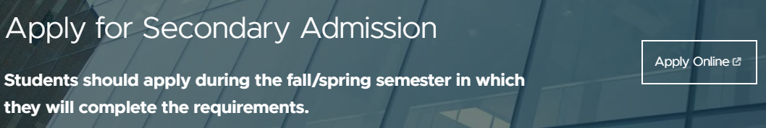
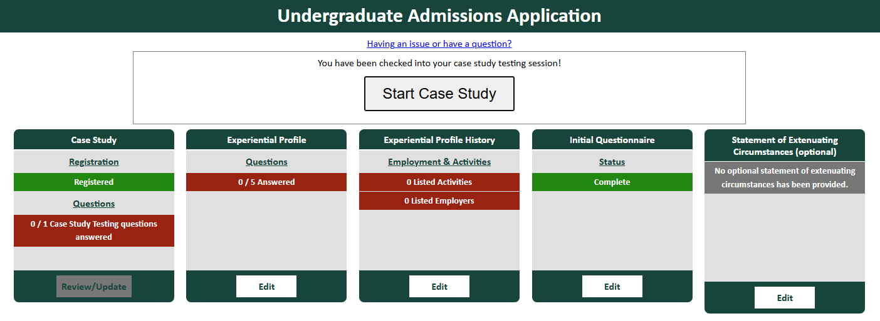
Online Application
Application Access – broad.msu.edu/undergraduate/admissions/secondary
Main Page

Slide 14
Online Application
Experiential Profile – Overview
30 points maximum
Profile Sections
  Employment & Activities
  Essay Questions
Scoring Categories (equally weighted)
  Motivation & Enthusiasm (passion for area of study)
  Engagement & Commitment (active engagement in past & present experiences)
  Resilience (demonstration of the ability to overcome a struggle and persist)
  Positive Self-Concept (confidence, self-esteem, independence)
  Written Communication Skills (use of English language conventions – mechanics, grammar)
Deadline: October 16, 5:00pm (Eastern Time)
  No “submit” button – we upload your saved content

Slide 15
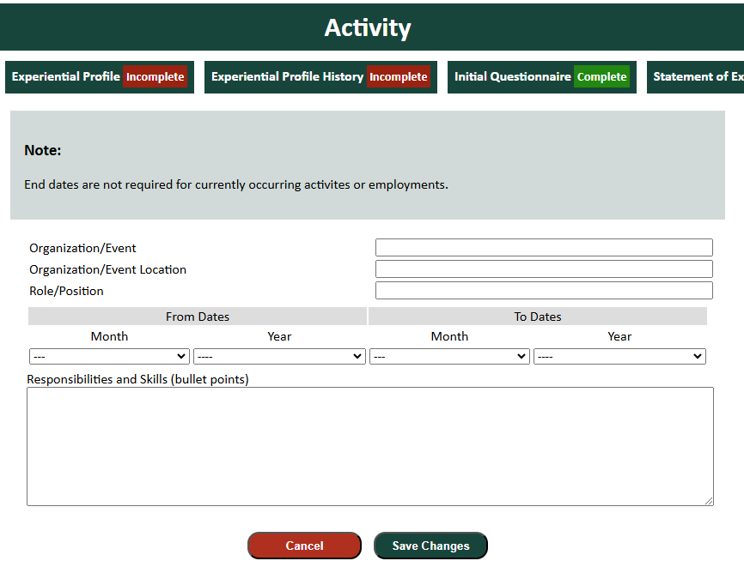
Online Application
Experiential Profile – Employment & Activities

Slide 16
Online Application
Experiential Profile – Employment & Activities
Post-high school experiences, if possible, but significant high school experiences acceptable (limit to junior & senior years)
Examples of “employment”: internship, part-time/summer job
Examples of “activity”: student organizations, study abroad programs (that you have already completed), community service, student government, athletic teams, leadership positions
Must include at least one employment OR one activity for profile to be accepted
Dates:
    Current involvement can be listed as through the end of this semester (December 2025) or leave the end date blank
    Employment that was exactly the same for multiple summers should include the entire date range (June 2025 – August 2025), with the word “Summers” at the top of the skills section

Slide 17
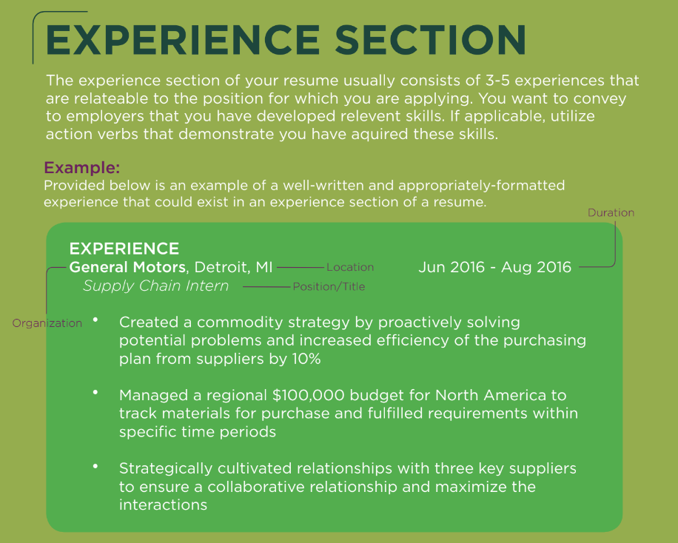
Online Application
Experiential Profile – Employment & Activities
Responsibilities & Skills section
  Bullet point format
  Like resume content – how many bullet points?
    As many as you need, but 3-5 is average
  Use WHO Method to develop bullet points

Slide 18

Online Application
Experiential Profile – Employment & Activities
Evidenced-based bullet points
  The W.H.O method provides evidence to the reader (employer) as it outlines: What you did, How you did it, and the Outcome or result of your action(s)
Tips
  Utilize a variety of action verbs – do not repeat!
  Quantify at any opportunity (percentages, dollar figures and/or hard numbers)

Slide 19
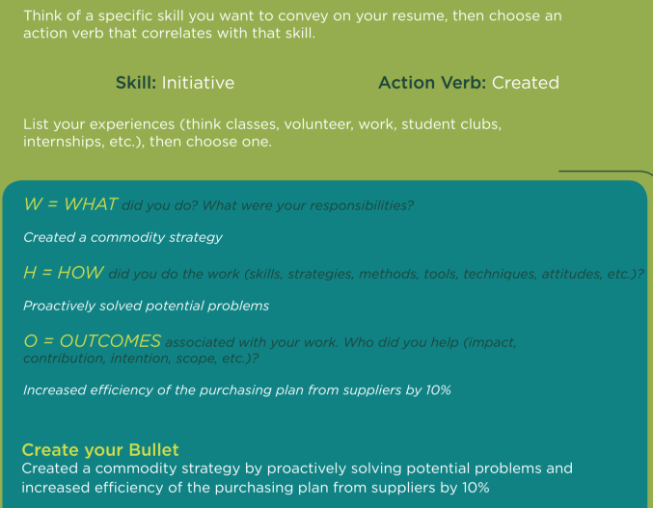
Online Application
Experiential Profile – Employment & Activities
The WHO Method in action

Slide 20
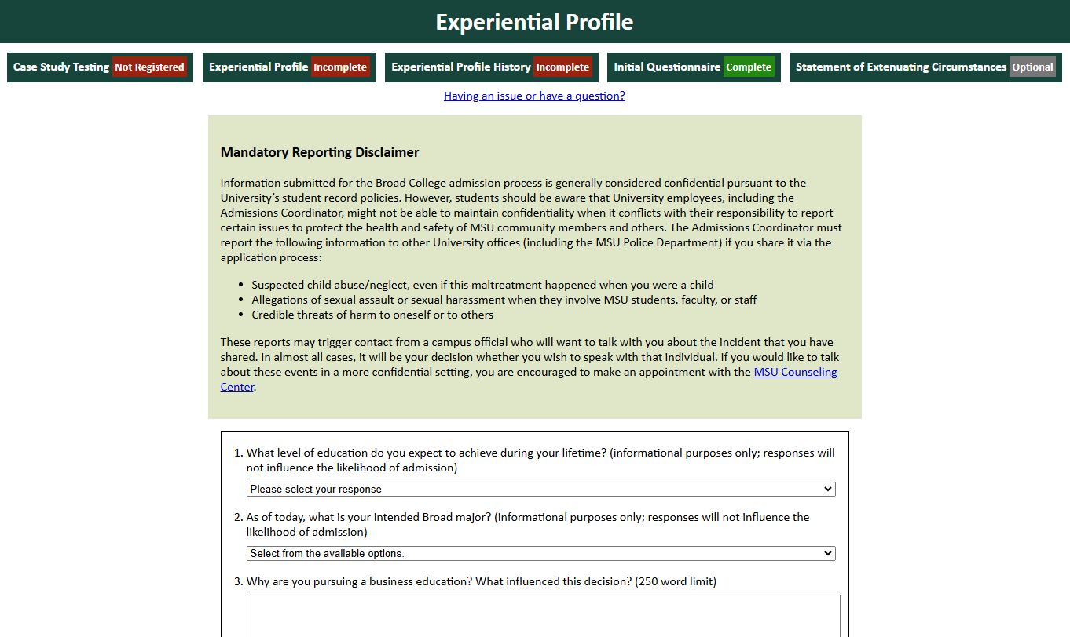
Online Application
Experiential Profile – Essay Questions
Education Level Achievement & Intended Major will not influence admission decision

Slide 21
Online Application
Experiential Profile – Essay Questions
Why are you pursuing a business education? What influenced this decision?
What do you see as a significant challenge you have faced? How did you overcome this challenge? Where did you go for support?
  NOTE: there is no restriction on the “type” of challenge
Discuss one accomplishment, activity, or experience that best demonstrates why you are a competitive candidate for admission to the Broad College. Confine your response to a single accomplishment/activity/experience that occurred no earlier than one year prior to high school graduation.
250-word maximum limit for each response

Slide 22
Online Application
Experiential Profile – Tips
Answer authentically! If you were asked the question in an in-person admission interview, is that what you would say? This is your opportunity to tell us about yourself. What do you want the reader to know about you (as related to the specific question)?
Have you addressed all parts of each essay question?
Follow instructions – Essay Question #3 asks for ONE activity/experience/accomplishment, not a combination of many things.
Think about the Case Study when you answer Essay Question #3. Is this something you can logically use when writing your Case Study response? Does it make sense?
There is no magic number of employment/activity entries that guarantees admission (or a particular score).
Don’t worry about what other people are including – tell us what YOU have done.
All sections of the employment/activity entry form are required – if you can’t complete the “responsibilities and skills” section, why are you including it in your application?

Slide 23
Online Application
Case Study – Access
Steps to complete the Case Study
  Click the “Register” button – you will be automatically “registered”
  Click the “Start Case Study” button at the top of the screen to access the Case Study – you will click this button any time you want to update/edit your content
  Be sure to click the “Save Changes” button any time you edit your content
A short instructional video covering these steps is available on the Secondary Admission page
There is no time limit to work on the Case Study; it is open until the application deadline (October 16, 2025, at 5:00pm (ET))

Slide 24
Online Application
Case Study – Overview
24 points maximum
Scoring Categories (equally weighted)
  Conventions (use of language, command of standard written English, grammar/mechanics)
  Organization (organization of thought and structure)
  Content (supported central claim)
  Critical Thinking & Analysis
500-word maximum limit
Writing Prompt
Consider your intended Broad College major, the career path you wish to pursue after graduation, and the accomplishment/activity/experience you discussed in the final Experiential Profile essay question.
Choose a current business event or issue related to your intended major and/or career path, and describe how the skills and knowledge you gained from that experience prepared you to engage with the event/issue.

Slide 25
Online Application
Case Study – Tips
Have you addressed all parts of the writing prompt? Can you identify where in your response each part is reflected?
Who asked you to solve a problem?
Think about your response to Essay Question #3 of the Experiential Profile. Have you chosen a current business event/issue that your EP response can mesh with?
International, national, regional, local…it’s all fair game.
Have you made it easy to read?

Slide 26
Online Application
Experiential Profile & Case Study – General Tips
Don’t use unnecessarily large words that you would not normally use. The “synonym” function is not always your friend.
Practice business writing (not creative/fiction writing) – clear, concise, complete.
Do your own work – the reader can tell if you are using someone else’s words.
Word count – how much is enough? Too much?
Answer all parts of the question/prompt
Quality counts – grammar, spelling, mechanics; college-level writing is expected.
Take these portions of the application process seriously – strong grades are not the only factor in the admission decision.

Slide 27
Online Application
Experiential Profile & Case Study – Resources
Palmer Center’s Broad Student Career Guide
(broad.msu.edu/career-management/undergraduate/)
Writing Center
(writing.msu.edu/)
This presentation
broad.msu.edu/undergraduate/admissions/secondary/
Reminder: advisors & peer coaches do not review individual student Experiential Profile and Case Study content.

Slide 28
Online Application
Statement of Extenuating Circumstances
The statement of extenuating circumstance is an opportunity for a student to share a circumstance beyond their control which impacted academic performance. Official supportive documentation of the extenuating circumstance must be submitted to admissions@broad.msu.edu. Statements without documentation will not be considered.
Examples of reasons to include a statement:
  Medical illness
  Family emergency
What if an extenuating circumstance occurs after the application closes?
  For full consideration, students can submit a statement via email to admissions@broad.msu.edu by the last day of the current semester. Substantiating documentation must accompany the statement.
Do not wait for the appeal process – use this section of the application if it applies to you!

Slide 29
Online Application
Application System Notes
Do not wait until the last minute to add content! There are no extensions.
If you leave the application open on your device, you will time out and new content will not be saved (there are messages that pop up) – always double-check by logging back in and viewing your content. This will also occur if you have the application open in multiple tabs.
There is no “submit” button. Applicants can edit their responses until the deadline (October 16, 2025, at 5:00pm ET).
If you want to save your application content, you must do so in your own document; you cannot access the content after the deadline (including for reapplication purposes in a future semester).

Slide 30
Transfer Credit
Repeating MSU courses through transfer credit
  Must earn 2.0/C grade or higher to receive transfer credit
  Once transcript is applied to your academic record, the original course grade will be removed from your GPA (and precore GPA, if it is a precore course)
  Grades from the other institution are not used in cumulative GPA calculation; see Slide 7 for how/when transfer course grades are used in the College Precore GPA
Credit from prior semester courses must be reflected on your academic record as “accepted credit” by December 21. Unofficial documentation cannot be accepted. “Pending” credit (TP) does not fulfill this requirement.

Slide 31
Transfer Credit
Taking courses at another school THIS semester? Declare current dual enrollment in the application system
  Institution name, course code, credit number, semester end date
  ONLY NON-MSU COURSES YOU ARE TAKING IN FALL 2025
Documentation of course completion with a transferrable grade must be submitted via email (admissions@broad.msu.edu ) by 5:00pm, December 22.
  Acceptable: Screenshot of final semester grade (like MSU’s SIS) or electronic unofficial transcript
  Unacceptable: letters from instructors/school officials, semester progress grades, D2L-style gradebook screenshots
Courses that end and/or grades that are not made available until after the December 22 deadline will not be considered in this semester’s admission decision process. Students who choose to complete courses that do not meet this deadline must apply in the next available application period.
Official transcripts showing final grades must be sent to the Office of Admissions (use admis@msu.edu email address). Do not have official transcripts sent to the Broad College – we cannot accept them on behalf of MSU.

Slide 32
Reapplying?
Improve your GPA
  Maximize repeat courses, if applicable
  Take a reasonable course load this semester to ensure maximum GPA improvement through high grades
  Use academic support services (tutoring, workshops, help rooms, study sessions, office hours)
Strengthen your non-academic factors
  Use the resources outlined in this presentation
  Proofread, proofread, proofread
Remember that this is a different admission cycle, so non-academic factor ratings, average GPAs and admission point cut-offs will be different
Do not expect the same score on the non-academic factors from one semester to the next. The Broad College continues to refine the scoring process, and submissions are read competitively across the applicant pool. A small score difference, even for the same submission, is not unexpected.
You must enter a new Experiential Profile & Case Study THIS SEMESTER – responses from previous semesters are not saved, and scores from previous semesters will not be used.

Slide 33
Broad Admission Myths & Misconceptions
You get extra points for attending an infosession, advising appointment, etc.
  While we track attendance at such events, it is for planning purposes, and to document your attendance so we are aware of your level of exposure to the admission process. No points are associated – but it is in your best interest to be as informed as possible.
You can’t apply if you have more than 56 credits/have already applied once, twice, etc.
  The Broad College does not limit access to the application based on credit total (once you meet the minimum application requirements), current major, or number of previous applications.
It’s easier to get admitted in _____ semester.
  Both fall and spring semester applicant pools are very large and very competitive.
Only ___% of applicants are admitted.
  The admit percentage varies each semester, dependent on the size of the applicant pool and the number of available seats.
Seek information from Broad College sources (website, UAS academic advisors) regarding the admissions process. Changes to academic criteria, questions, scoring, and procedures occur periodically; Broad staff outside UAS and older students may not be aware of such updates and so may be unknowingly giving you incorrect advice.

Slide 34
Spring Schedule Planning
Class Schedule Planning Session (October 23)
  Overview of Business Core and general graduation requirements
  Opportunity to request personalized Spring 2026 course plan
When can I enroll in Broad-restricted courses?
  As soon as you get the admission decision message (January 6 after 5pm)
What do I enroll in when my enrollment appointment opens (before the admission decision)?
  Enroll in courses you will take if you are not admitted to Broad
  Explore majors outside Broad, meet with a University Advisor or advisors in specific majors (advising.msu.edu/advising-by-college)
  DO NOT WAIT FOR THE ADMISSION DECISION TO ENROLL! It is easier to change your schedule to Broad courses than to start from scratch if you are not admitted.

Slide 35
Questions?
Read the FAQ sections
broad.msu.edu/undergraduate/admissions/secondary/
Broad admissions email
admissions@broad.msu.edu
  All admission-related messages are sent from this address – READ THEM
Broad advising email
undergrad@broad.msu.edu

