Slide 1
Networking Introduction

Slide 2
Networking Introduction Who Are We?
Matt Calvano
Joe Leger
William Weidendorf

Slide 3
Finding People to Reach Out

Slide 4
Reaching Out Where to Look for Connections
FMI Friends List
Great starting point, everyone here has access.
FMI Advisory Board
Remember though, their time is exceedingly scarce.
LinkedIn
Searching for alumni from other parts of the university
Investor Relations and Equity Reports
Friends and Family
Don’t underestimate the power of this group

Slide 5
Starting Your Efforts

Slide 6
Starting Networking How to Proceed
Start with the Junior Staff first
Why?
They remember what the process was like for them
Understand HR and recruiting better
Generally more available and more willing to help
Important to Move Through the Ranks
Remember to gear your questions and conversations to topics appropriate to the person

Slide 7
Initial Contact

Slide 8
Initial Contact Making that initial connection
Email
Dear So and So,
My name is William Weidendorf and I am currently a student at Michigan State studying Finance as part of the FMI program. I have been trying to expand my knowledge and understanding of the financial services industry beyond what we learn in reading our textbooks and in class.
I was hoping that you might have some time to talk over the next week to discuss your experiences at Hedge Fund, Bank 1, and Bank 2 and to share any other advice you might have to better prepare me for a career in the financial services industry. My schedule is fairly flexible, and my evenings and weekends are typically available to talk.
Thanks for your consideration, and I look forward to talking to you soon.

Slide 9
Initial Contact Be (Reasonably) Persistent
Email
If no response from your first email, circle back around a week later.
Repeat this another time, if still no response.
If, after 3 attempts to reach out, you still hear nothing, wait 3 to 4 weeks and then try one last time.
Consider Your Timing
It’s going to be impossible to reach someone in the research function in the middle of earnings season.

Slide 10
Initial Contact Moving to a Phone Call
Phone Call
Once you have your first phone call established, make a cheat sheet for yourself about some general questions you’d like to ask:
Can you tell me a little bit about your background and how you started working at x?
What trends are you noticing in the industry that have gone under the radar?
Research Ahead of Time
At minimum, look up someone’s LinkedIn profile and have some basic knowledge of who they are before your phone call.

Slide 11
Staying In Touch

Slide 12
Staying In Touch The Dreaded Follow Up
Follow up emails
Right after your phone call, make sure that you send a simple thank you note to the person with whom you spoke.
Follow up phone calls
Touch base on some regular interval with people, and develop the things that you talked about in your first conversation.
Personal Networking Trips
Extremely important to visit in person

Slide 13
Staying In Touch The Dreaded Follow Up
But, what do I talk about on that second phone call?

Slide 14
Growing Your Network

Slide 15
Growing Your Network Or How To Leverage Relationships
Most People Want to Help
After you’ve invested in a relationship, many people are more than willing to help in whatever way they can.
You Need to Ask
People can’t help unless they know what you need.
Every Relationship Is Different
Just because person A was willing to refer you immediately doesn’t mean that B, C, or D will. Don’t force this on a relationship.

Slide 16
Keeping Track of Everyone

Slide 17
Keeping Track of Everyone Excel & Word
Word Notes
Keep a folder of notes on each person you talk to
Dropbox
It’s free and allows you access wherever you are

Slide 18
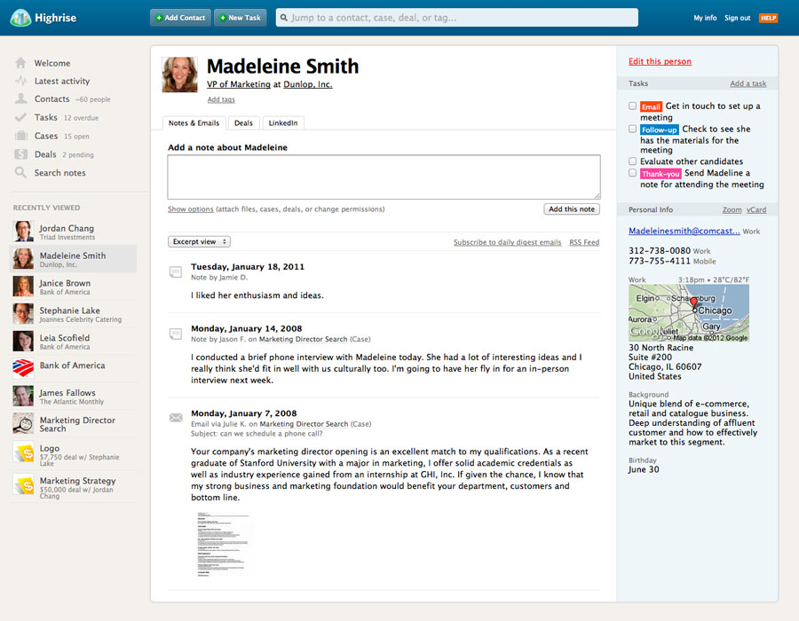
Keeping Track of Everyone CRM Software

Slide 19
Things to Remember

Slide 20
Things to Remember Keep These In Mind!
Submit Your Resume to HR
You have to do it. Don’t miss out on an opportunity because you didn’t follow procedure.
Make an Ask!
People can’t (easily) help unless you tell them what you need, such as:
Keeping in touch
Referrals
Resume drop
Never Know How People Are Connected
Be careful of what you say, and to whom you say it!

